Slide 1
Object Oriented Programming
Java – Packages, Exceptions Handling

Slide 2
Java – Packages
Packages are used in Java in order to prevent naming conflicts, to control access, to make searching/locating and usage of classes, interfaces, enumerations and annotations easier, etc.
A Package can be defined as a grouping of related types(classes, interfaces, enumerations and annotations ) providing access protection and name space management.
Some of the existing packages in Java are::
java.lang - bundles the fundamental classes
java.io - classes for input , output functions are bundled in this package

Slide 3
Package Example
EXAMPLE 1:
package animals;
interface Animal {
public void eat();
public void travel();
}
EXAMPLE 2:
package com.apple.computers;
public class Dell{
}
class Ups{
}

Slide 4
import Keyword
If a class wants to use another class in the same package, the package name does not need to be used. Classes in the same package find each other without any special syntax
Following techniques for referring to a class in a different package
Pcakagename.classname;
import Pcakagename.classname;
import Pcakagename.*;

Slide 5
Java - Exceptions Handling
An exception is a problem that arises during the execution of a program. An exception can occur for many different reasons, e.g.
A user has entered invalid data.
A file that needs to be opened cannot be found.
A network connection has been lost in the middle of communications or the JVM has run out of memory.
1/0
etc

Slide 6
Categories of Exceptions
Checked exceptions:
A checked exception is an exception that is typically a user error or a problem that cannot be foreseen by the programmer. For example, if a file is to be opened, but the file cannot be found, an exception occurs. These exceptions cannot simply be ignored at the time of compilation.
Runtime exceptions:
A runtime exception is an exception that occurs that probably could have been avoided by the programmer. As opposed to checked exceptions, runtime exceptions are ignored at the time of compilation.
Errors:
These are not exceptions at all, but problems that arise beyond the control of the user or the programmer. Errors are typically ignored in your code because you can rarely do anything about an error. For example, if a stack overflow occurs, an error will arise. They are also ignored at the time of compilation.

Slide 7
Exception Hierarchy:
All exception classes are subtypes of the java.lang.Exception class.
The exception class is a subclass of the Throwable class.
Other than the exception class there is another subclass called Error which is derived from the Throwable class.

Slide 8
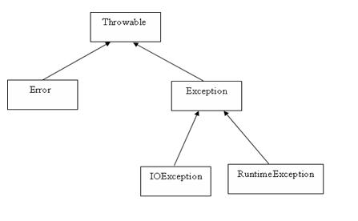
Exception Hierarchy:

Slide 9
Try-catch block
try
{
//Protected code
}catch(ExceptionName e1)
{
//Catch block
}

Slide 10
Example
import java.io.*;
public class ExcepTest{
public static void main(String args[]){
try{
int a[] = new int[2];
System.out.println("Access element three :" + a[3]);
}catch(ArrayIndexOutOfBoundsException e){
System.out.println("Exception thrown :" + e);
}
System.out.println("Out of the block");
}
}

Slide 11
Multiple catch Blocks:
try
{
file = new FileInputStream(fileName);
x = (byte) file.read();
}catch(IOException i)
{
i.printStackTrace();
return -1;
}catch(FileNotFoundException f) //Not valid!
{
f.printStackTrace();
return -1;
}

Slide 12
The finally Keyword
public class ExcepTest{
public static void main(String args[]){
int a[] = new int[2];
try{
System.out.println("Access element three :" + a[3]);
}catch(ArrayIndexOutOfBoundsException e){
System.out.println("Exception thrown :" + e);
}
finally{
a[0] = 6;
System.out.println("First element value: " +a[0]);
System.out.println("The finally statement is executed");
}
}
}

